Slide 1
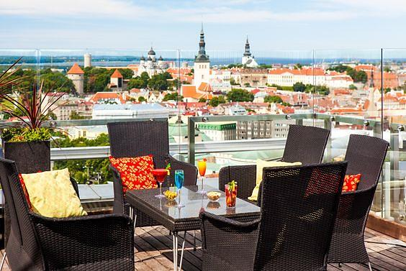
1,2,3 … Time for Health
Healthy eating.
Estonia 25 – 29. 09. 2023

Slide 2
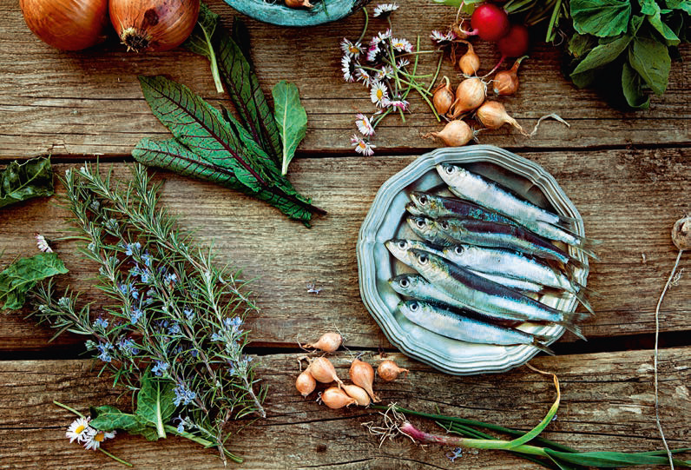
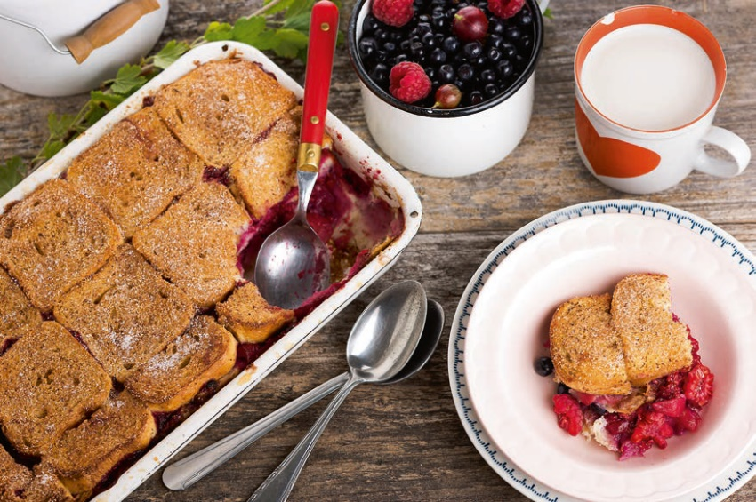
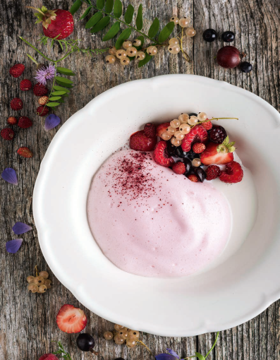
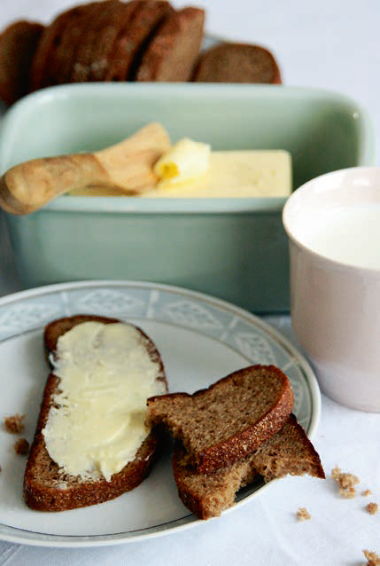
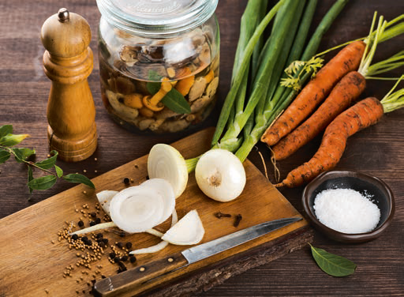
Healthy diet in Estonian style

Slide 3
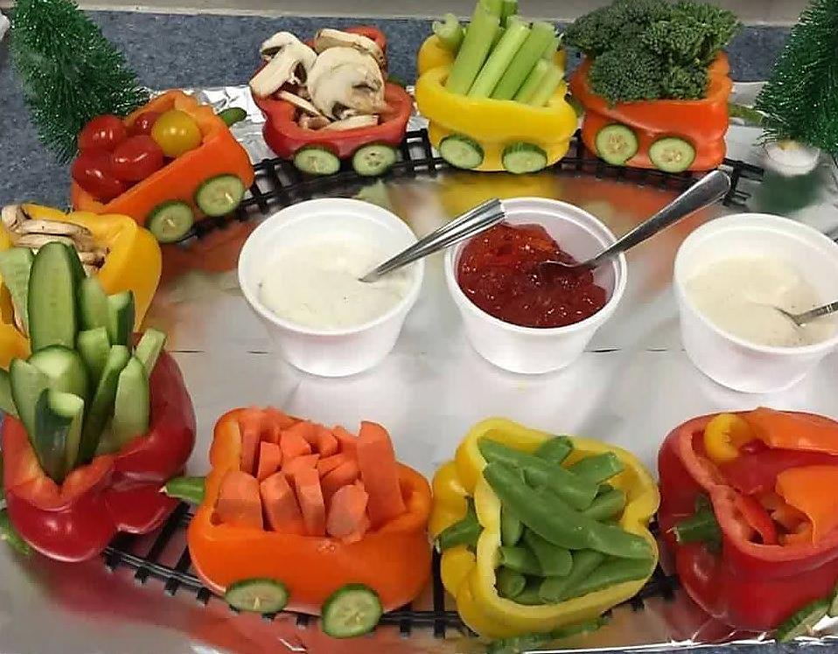
Here are some Golden Rules of Nutrition in Estonia:
Grow yourself or gather in the forest;
Eat organic food;
Vegetables and fruits. Vegetables and fruits once again! Eat 5 fruits or 5 vegetables every day;
Prepare traditional dishes;
Eat local foods;
Follow table manners;

Slide 4
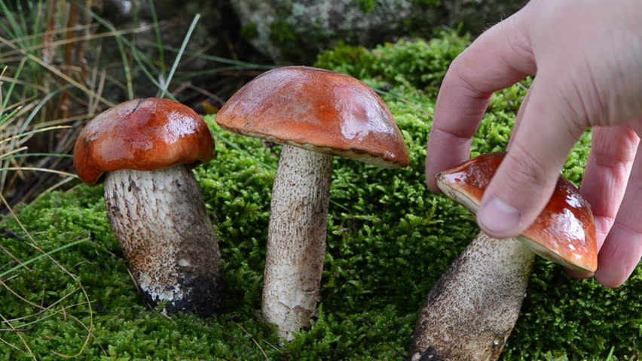
Grow yourself or gather in the forest
Estonians like to know where their food comes from, and we have strong connection with nature. Many families get together and spend their time in the local forests picking berries, mushrooms and herbs. Many people spend their free time growing vegetables and fruits themselves.

Slide 5
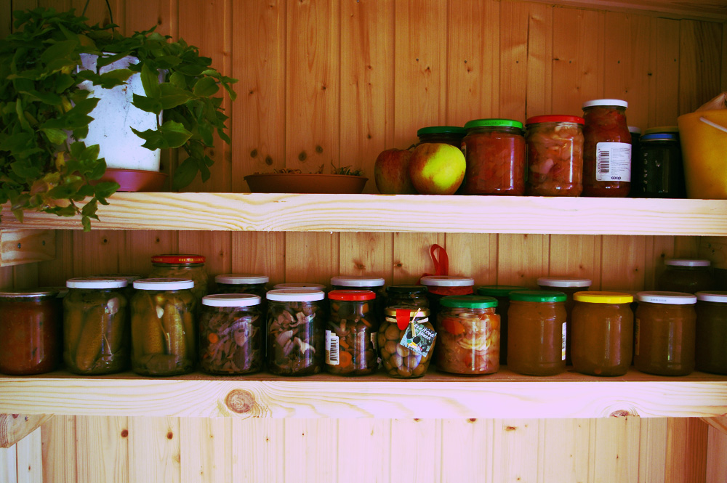
Eat Organic Food
Estonians love to pickle something.
We like to preserve our harvest for winter storage. You can buy pickled vegetables in all our supermarkets.

Slide 6
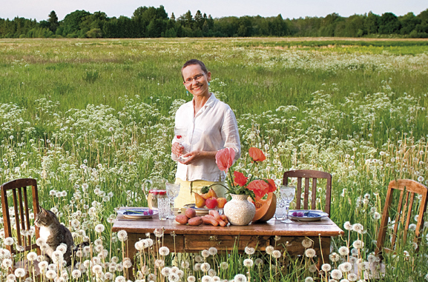
You can taste or buy organic products at different farms all over Estonia, for example, at the Konju farm, which is next to our living place.

Slide 7
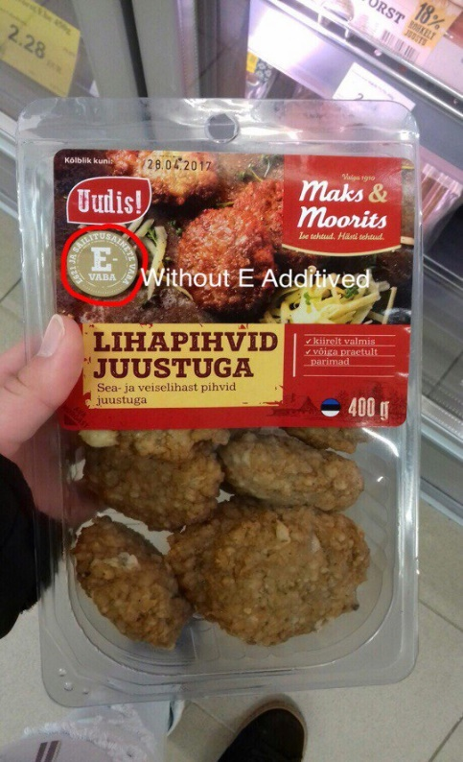
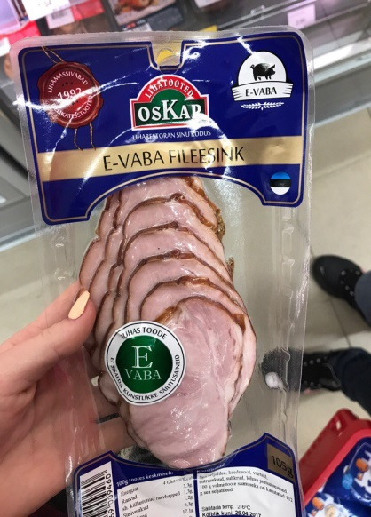
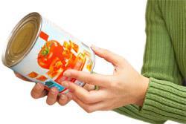
Without E-numbers
Many people in Estonia read labels on products to check the purity of foods. The Green Key label on the products indicates that they have been produced in association with organic producers.

Slide 8
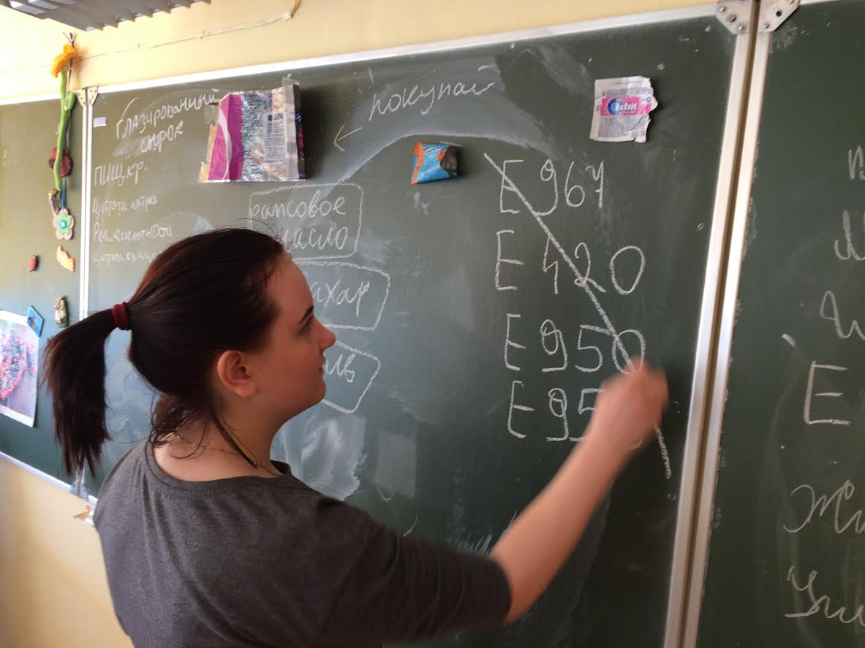
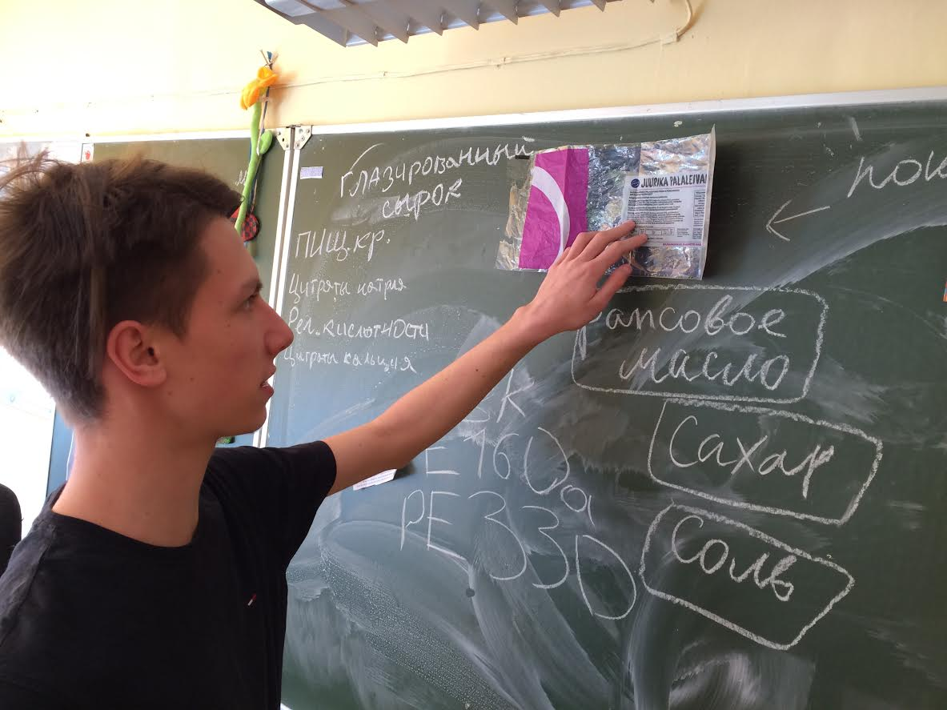
We have studied the influence of E-numbers and found out the most dangerous of them.

Slide 9
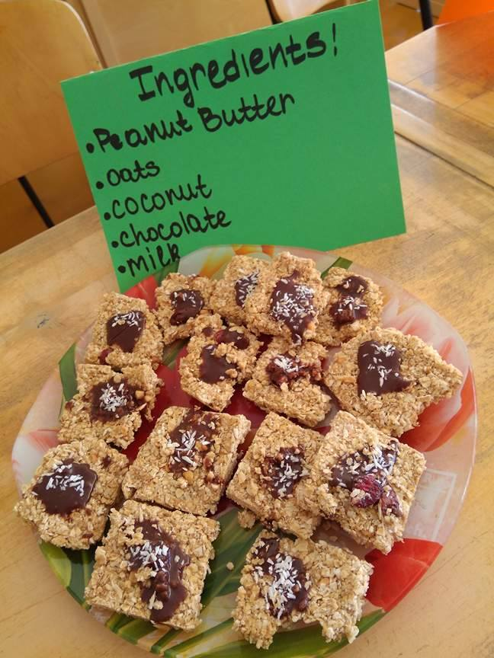
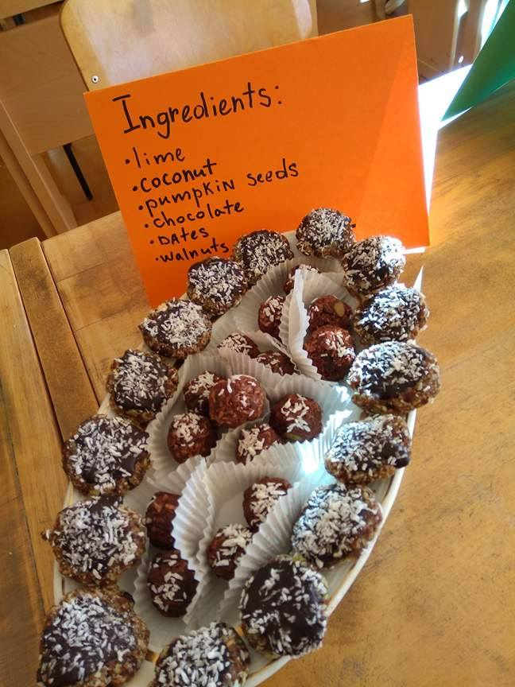
You can cook very healthy sweets without E-numbers

Slide 10
Residents of Estonia drink natural mineral water called "Värska"

Slide 11
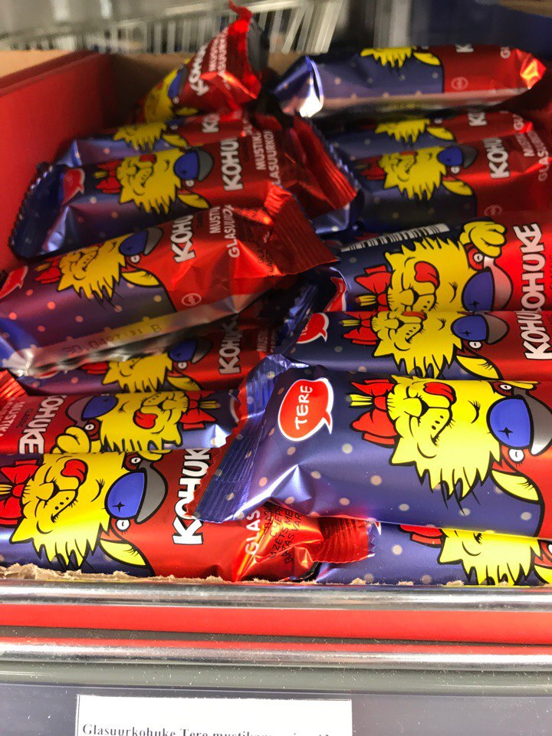
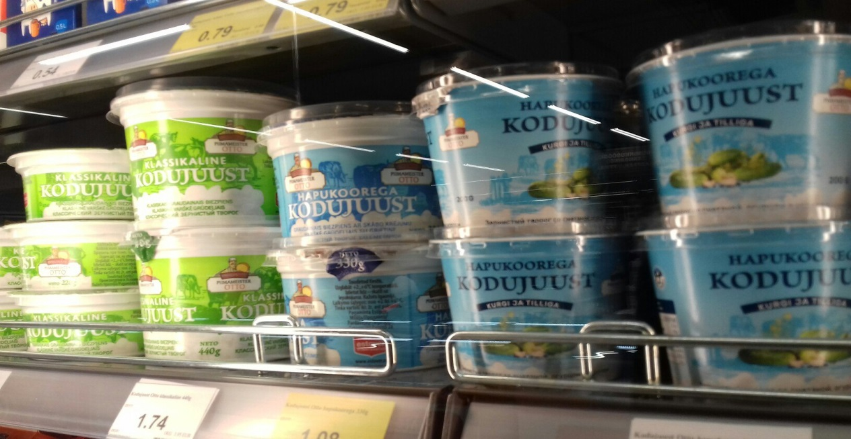
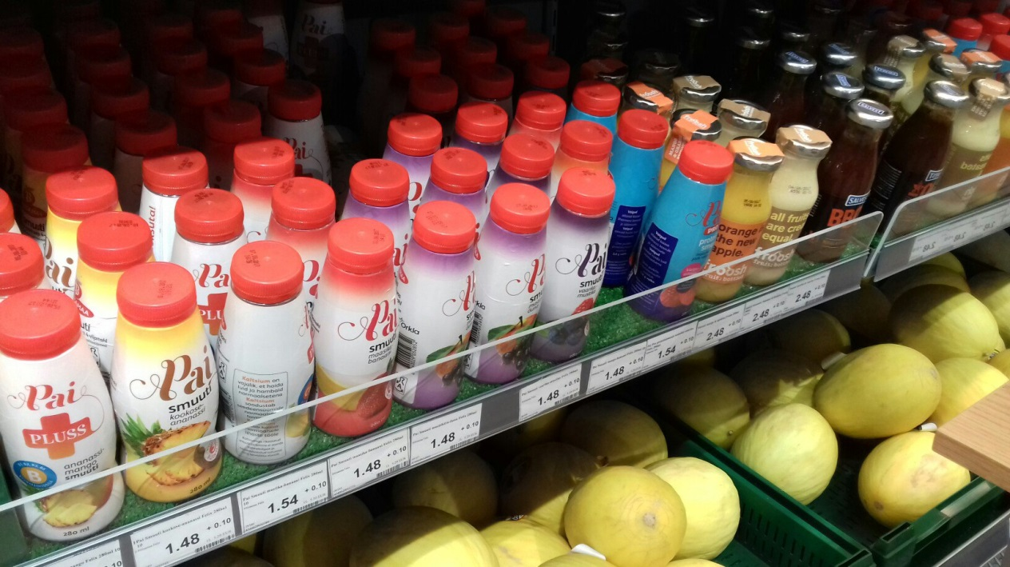
Estonia is rich in dairy products, and there is plenty to choose from.
In all our shops you can get lost among cottage cheese puddings and chocolate-covered curd bars called "kohuke“ as well as yoghurt and sour cream.

Slide 12
Here are some public advertisements of healthy eating in Estonia

Slide 13
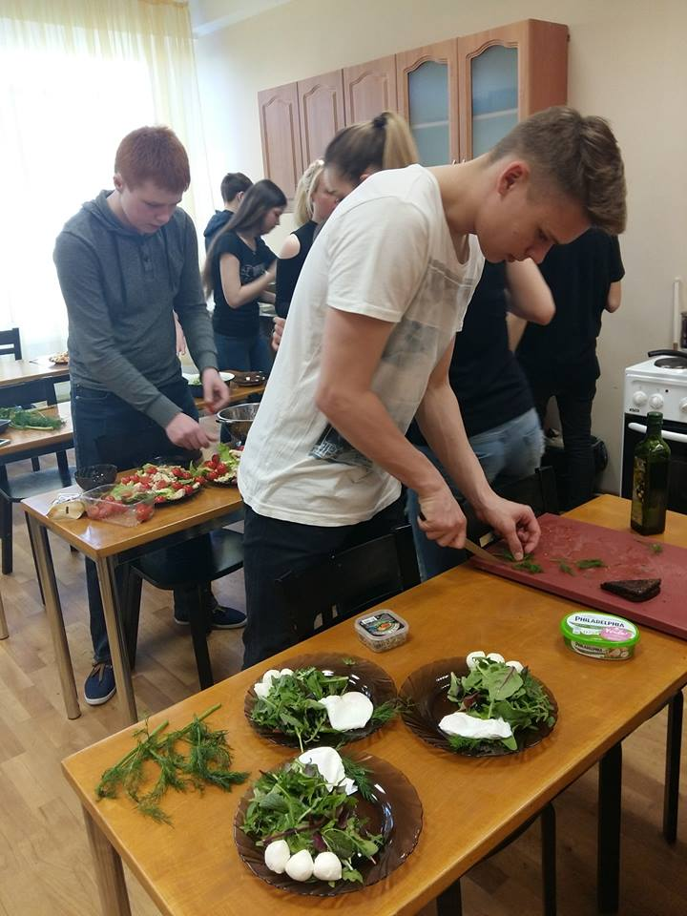
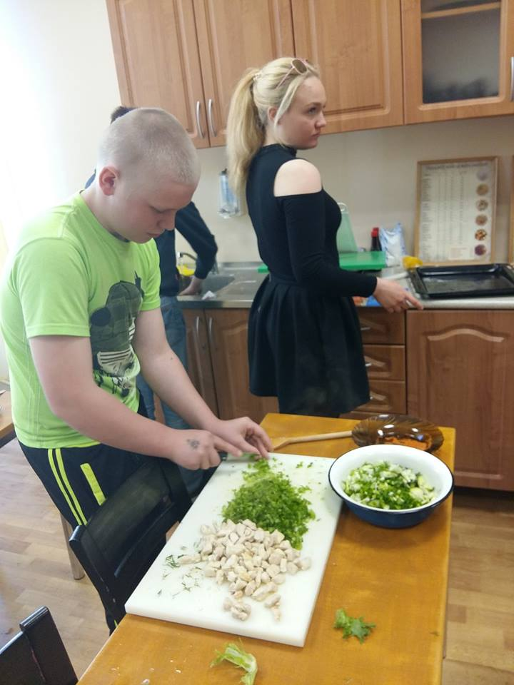
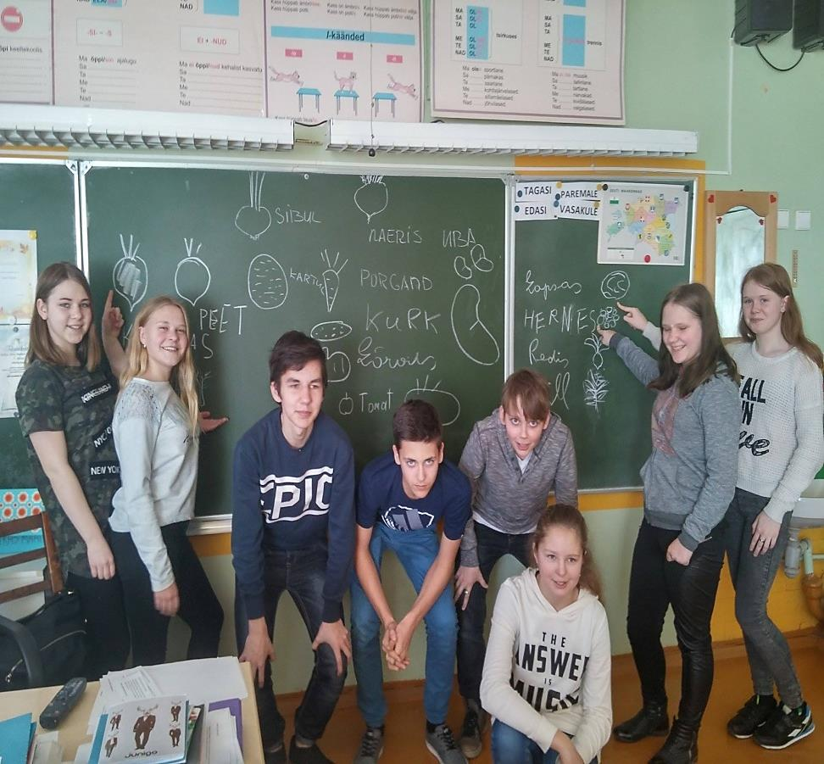
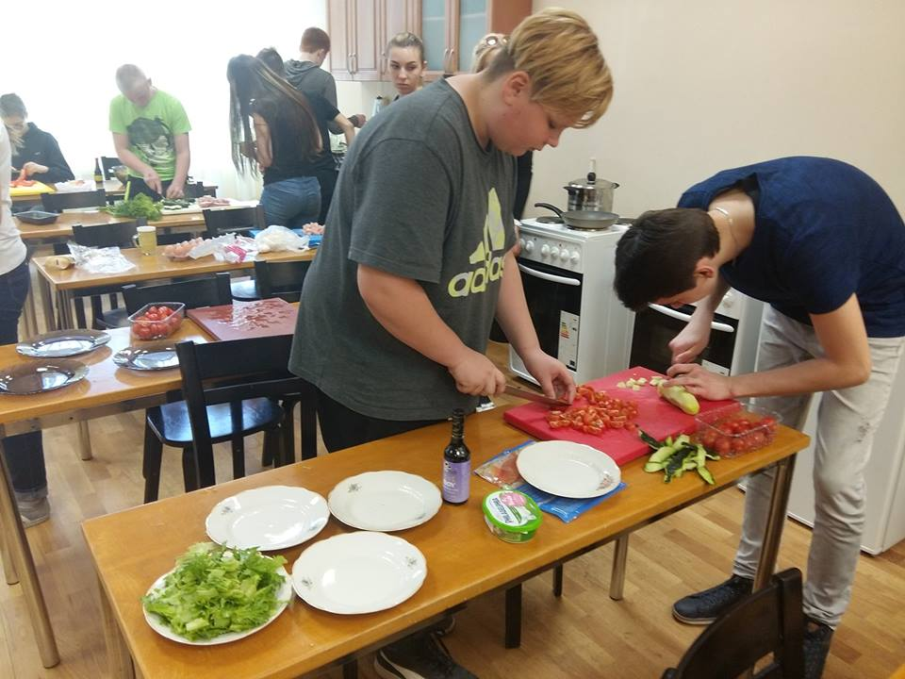
Our students have studied the topic `Healthy Food`

Slide 14
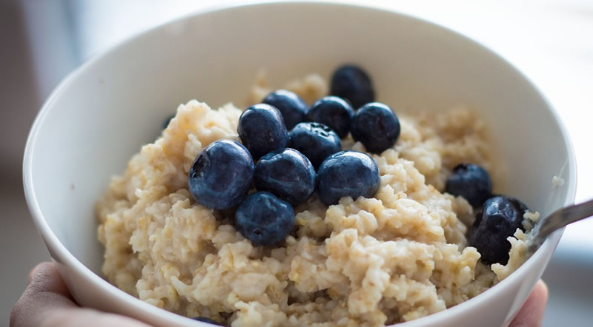
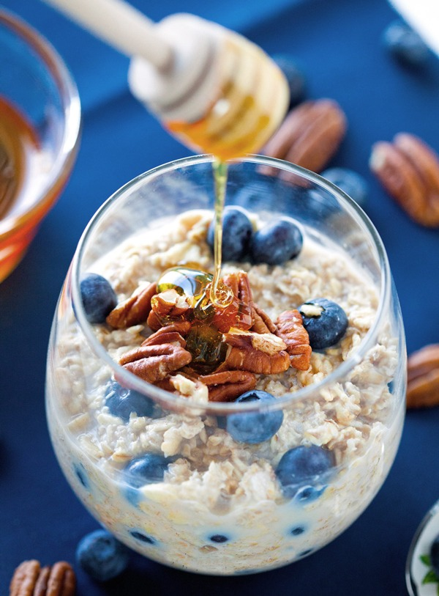
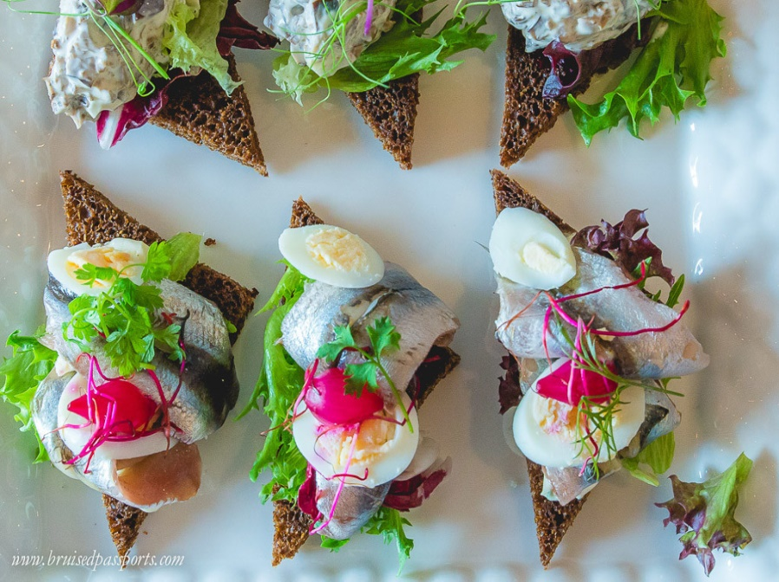
Our breakfast set consists of different cereals, oatmeal with toast, fruit salads, muesli, yoghurt, sandwiches, milk or tea.

Slide 15
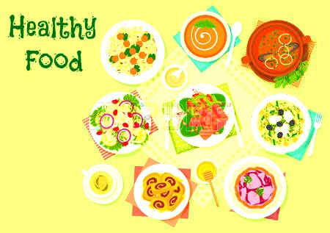
People of Estonia like to prepare healthy traditional dishes

Slide 16
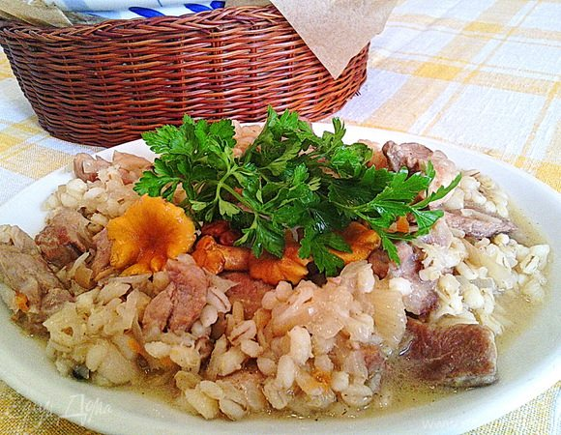
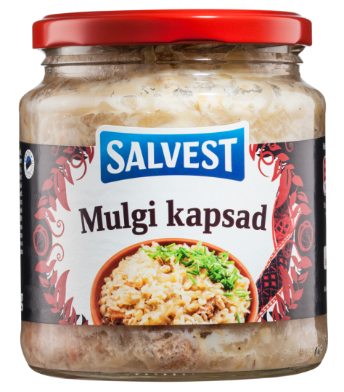
Mulgikapsad is a traditional dish of Estonia
It is cooked with pork and barley. It looks unappetizing, but it is very tasty.

Slide 17
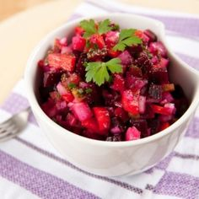
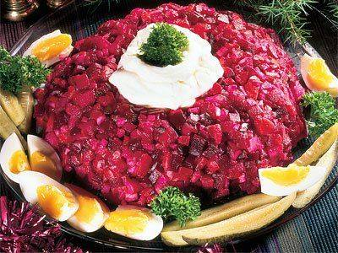
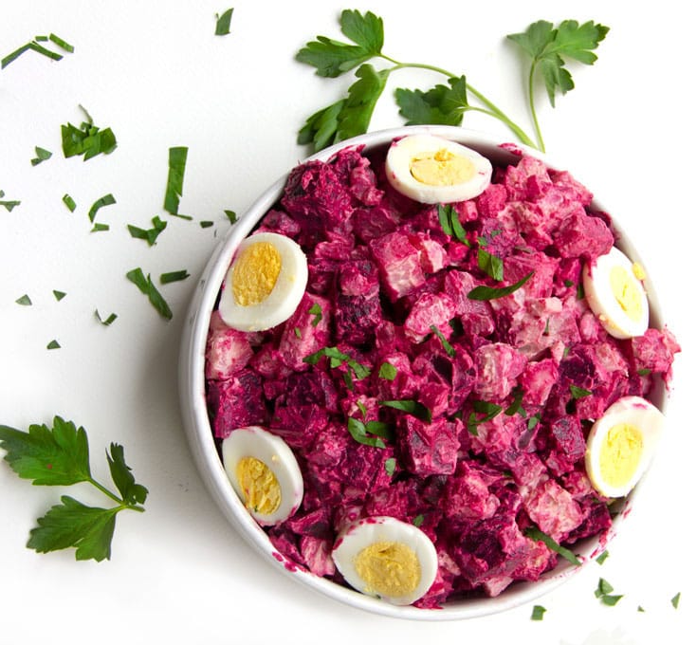
Rosolje is a potato-beet salad, without which no festive table can do in Estonia.

Slide 18
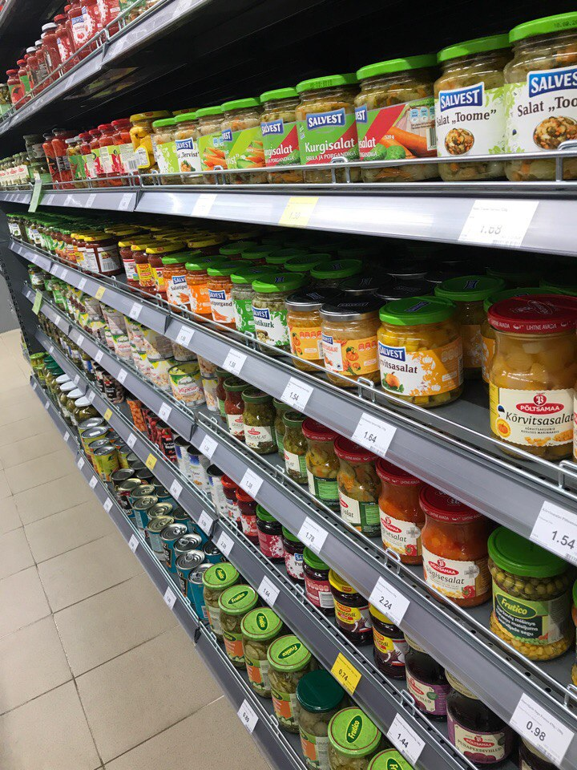
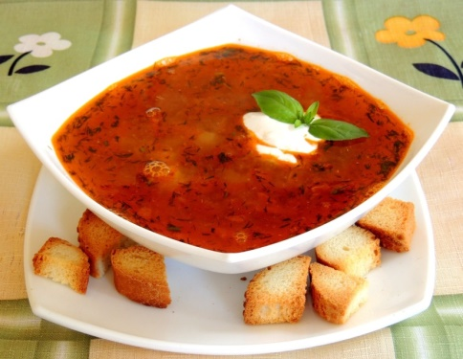
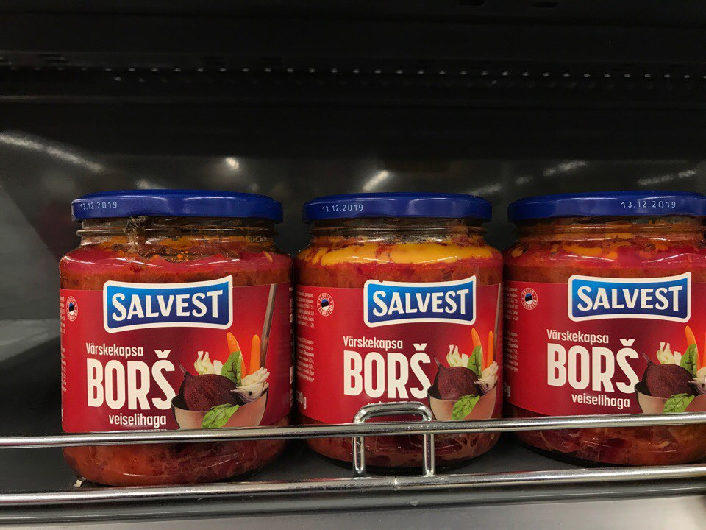
Soups make up the main part in the diet of every person living in Estonia.
Many people go to a local store after work and buy soups in jars.
This soup is easy to cook. First you open the jar, put the ingredients in water, let it boil and the soup is ready!

Slide 19
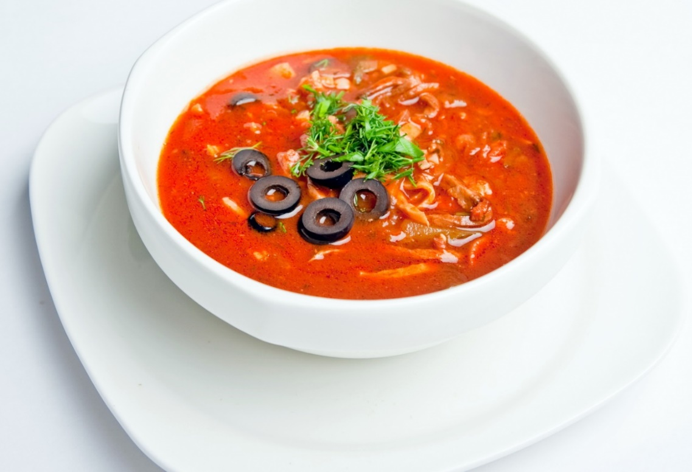
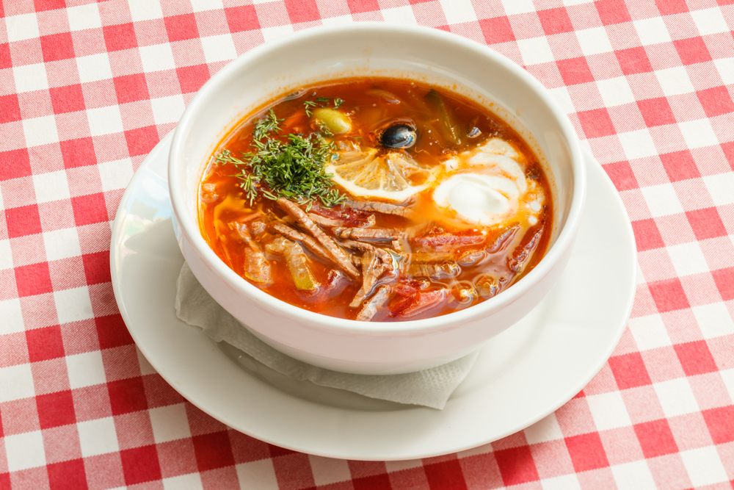
If we talk about Estonian lunch, the answer is simple – soup, soup and soup. One of the most popular soups in Estonia is Solyanka.

Slide 20
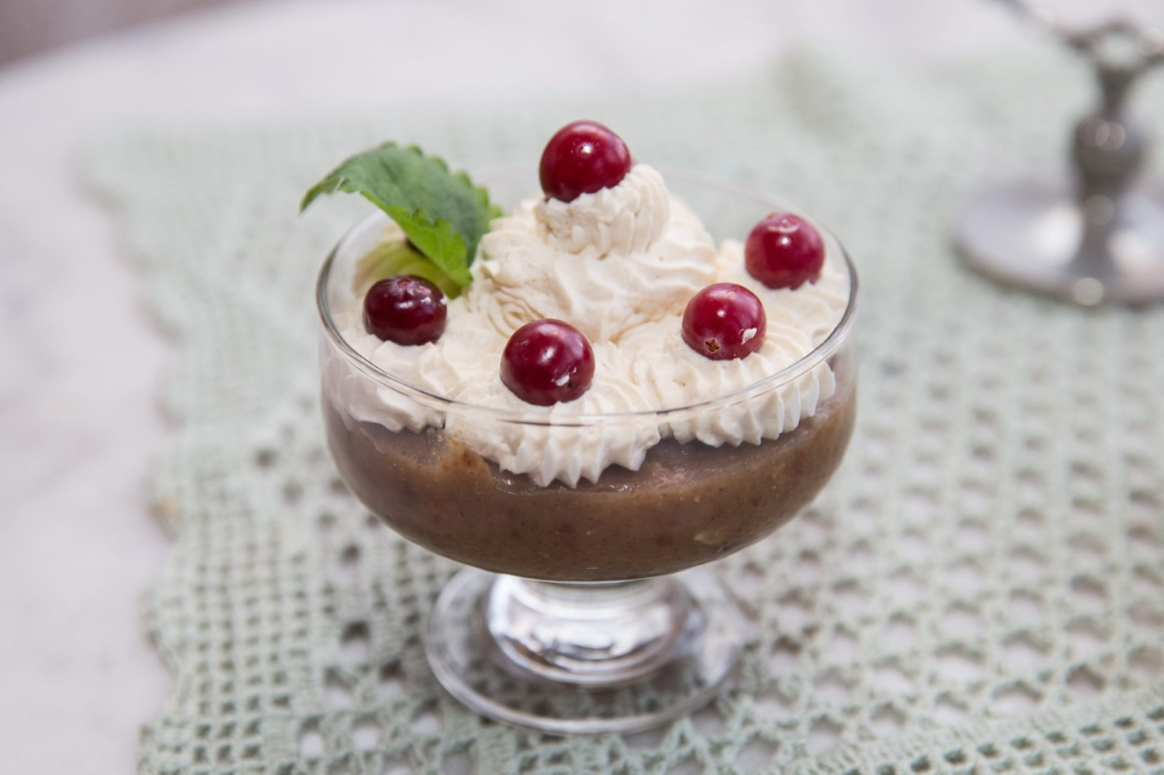
A unique type of Estonian soup is leivasupp, a kind of sweet soup that is made from black bread and apples, and is usually served with sour cream or whipped cream, often seasoned with cinnamon.

Slide 21
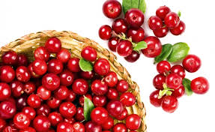
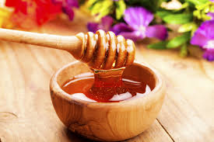
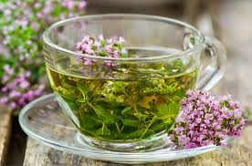
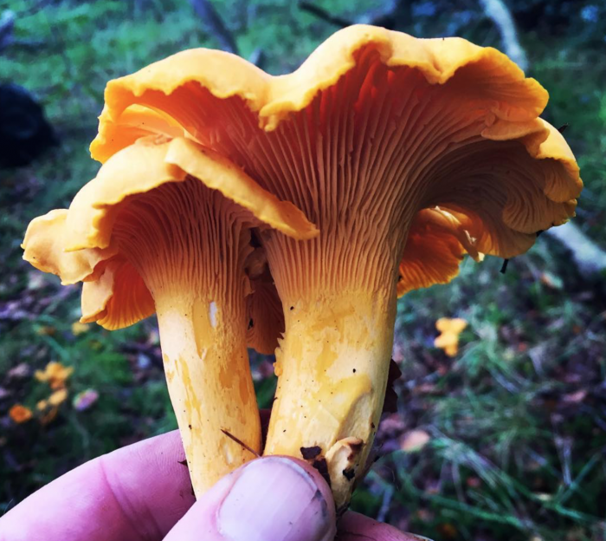
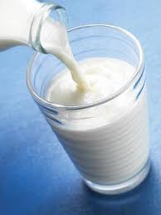
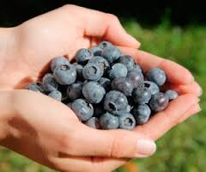
Estonian super food
cranberry
honey
herbal tea
SUPERFOOD
chanterelle
blueberries
kefir

Slide 22
Bread has at least three different names in Estonian – that's how serious we take it.
Black rye bread is part of almost all dishes in Estonia.
Instead of wishing "bon appetite", Estonians say jätku leiba ("may your bread last").

Slide 23
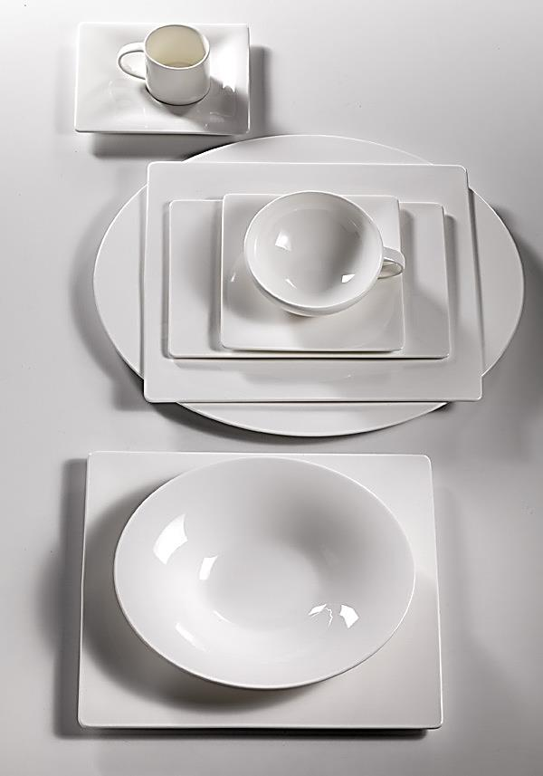
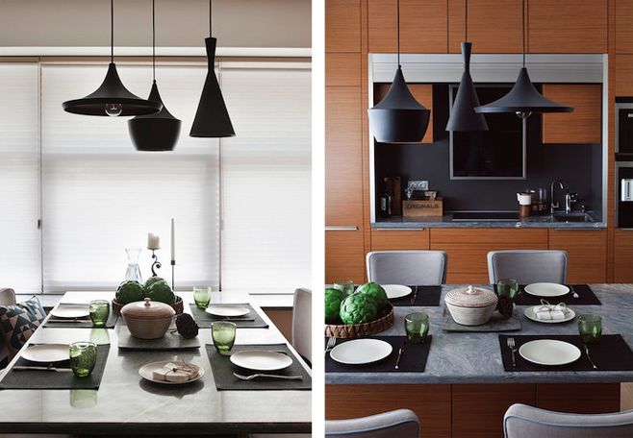
Style and table manners are important for healthy eating in Estonia. Setting the table we follow the minimalist style.
functionality, simplicity, elegance

Slide 24
Some common Table Manners in Estonia
Table manners in Estonia are relatively formal.
Remain standing until you are invited to sit down.
Do not start eating until the hostess starts or someone says “Head isu!" (“Bon appetit").
Don`t put your elbows on the table.
Make a compliment to the hostess for the prepared dish.
Try to finish everything on your plate.

Slide 25
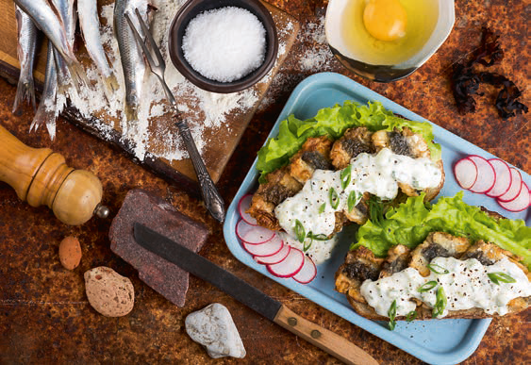
We love healthy food of Estonia!
Thank you for your attention!

